Slide 1
Why A Pretribulationary Rapture?
November 7, 2021

Slide 2
Why a Pretribulationary Rapture?
Four questions to answer:
What does “rapture” mean?
Will there be an eschatological rapture?
Will the rapture be partial or full?
Will the rapture be pre, mid, or post in relationship to Daniel’s 70th Week? (at the beginning, in the middle or at the end of the seven-year tribulation period)

Slide 3
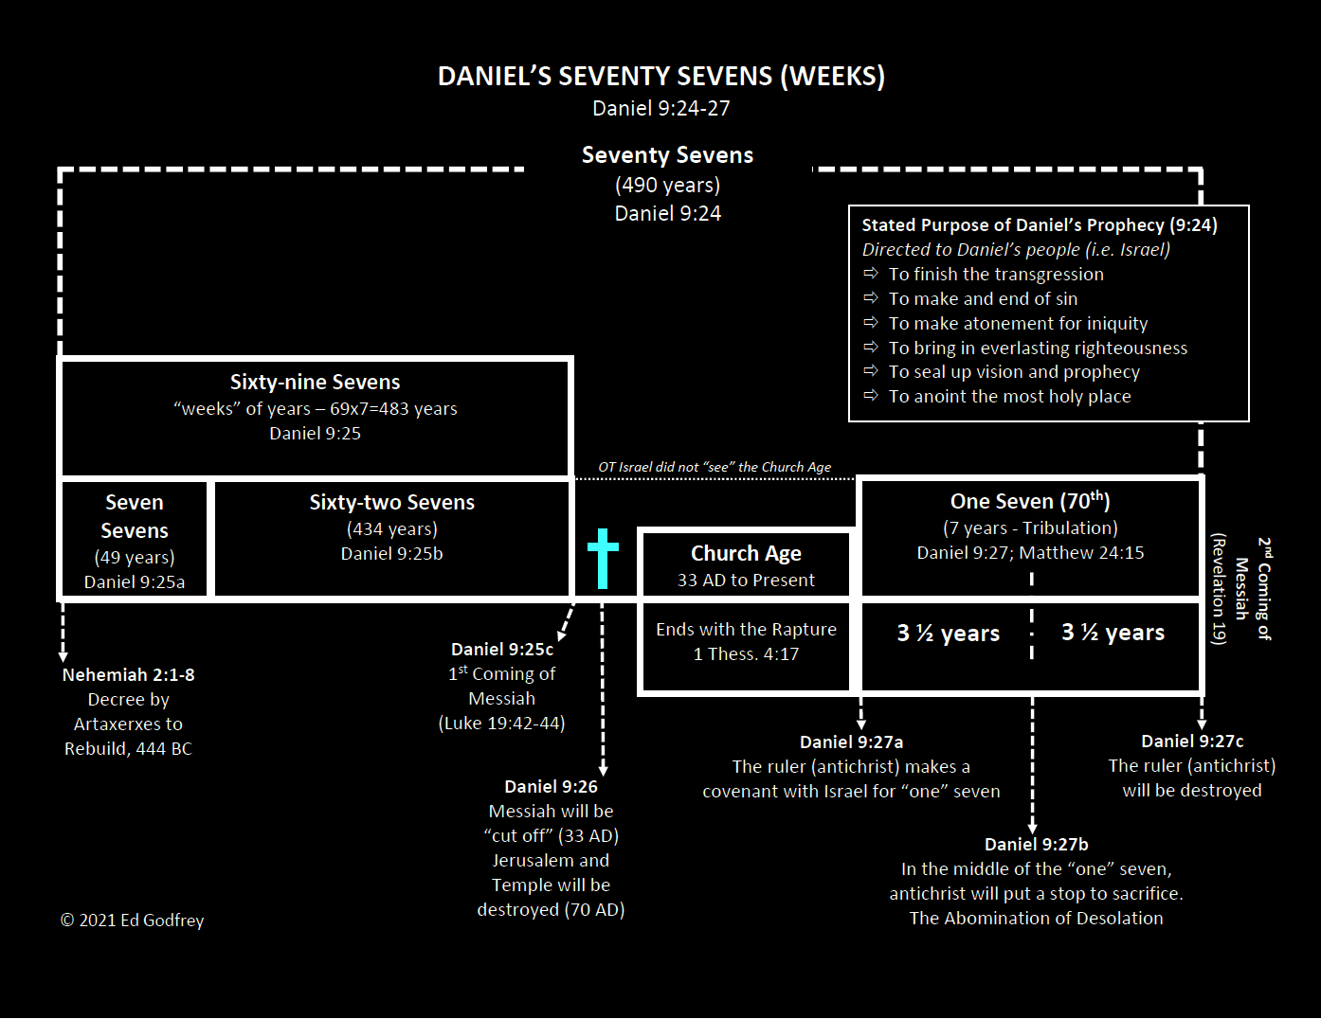
Week = a unit of seven (like our word “dozen”)
173,880 days

Slide 4
Jesus started His ministry in the 15th year of Tiberius (see Luke 3:1). Tiberius started his reign in 14 A.D., so Jesus’ ministry started in 30 A.D. Anderson believes that Jesus celebrated four Passovers during His ministry, one each in 30, 31, 32 and His final Passover in 33 AD. With the help of lunar charts, we can calculate the exact date of ancient Passovers, so it is possible to calculate the day of Jesus’ triumphal entry into Jerusalem as April 6, 33 A.D.
From 444 B.C. to 33 A.D. there are 476 years on the Julian calendar (not 477 years, because there is no year zero)
476 years x 365 days = 173,740 days
Adjusting for the difference between March 14 and April 6 adds 24 days
Adjusting for leap years over a period of 476 years adds 116 days
The total number of days from March 14, 445 B.C. to April 6, 32 A.D. is 173,740 + 24 + 116 = 173,880 days

Slide 5
In Luke 19:42, during His triumphal entry, presenting Himself to Israel as their humble King, knowing that He will be rejected, said this about the city and the people of Jerusalem: “If you had known in this day, even you, the things which make for peace! But now they have been hidden from your eyes.”
Jesus marks that they should have known something about this day, 173,880 days after Daniel’s prophecy.

Slide 7
What does the word “rapture” mean?
The English noun and verb “rapture” comes from the Latin word raptura, which in Latin Bibles translates the Greek word harpazo – and is used fourteen times in the New Testament. The basic idea of the word is “to suddenly remove or snatch away.” There are three basic ways in which the word is used:
It can speak of stealing or plundering (Matthew 11:12; 12:29; 13:19; John 10:12, 28, 29).
It can speak of removing (John 6:15; Acts 8:39; 23:10; Jude 23).
It can speak of being caught up to heaven
It is used of Paul’s third heaven experience ^{(2 Corinthians 12:2)}
It is used of Christ’s ascension to heaven ^{(Revelation 12:5)}

Slide 8
Will there be a future (eschatological) rapture?
YES!
How do we know?
The Bible tells us so!
1 Thessalonians 4:17 – “16 For the Lord Himself will descend from heaven with a shout, with the voice of the archangel and with the trumpet of God, and the dead in Christ will rise first. 17 Then we who are alive and remain will be caught up together with them in the clouds to meet the Lord in the air, and so we shall always be with the Lord.”

Slide 9
1 Corinthians 15:51-52
51 Behold, I tell you a mystery; we will not all sleep, but we will all be changed, 52 in a moment, in the twinkling of an eye, at the last trumpet; for the trumpet will sound, and the dead will be raised imperishable, and we will be changed.

Slide 10
Will the rapture be partial for full?
Will some believers be left behind?
Some have suggested that the rapture spoken of in 1 Thessalonians 4:16-17 and 1 Corinthians 15:51-52 will only be a partial rapture, not a rapture of all who believe. Some believe that participation in the rapture is not based upon one’s true salvation but rather is conditional, based upon one’s deserving conduct.
The theory of a partial rapture rests upon the idea that passages like Mathew 25:1-13, I Thessalonians 5:4-8 and Hebrews 9:28, stress obedient watching and waiting. The result of this idea is that only part of the church is raptured and those who are not raptured endure through a portion of or through the entire 70th week of Daniel.

Slide 11
Problems with the partial rapture theory
1 Corinthians 15:51 states that “all” will be changed, not just some
A partial rapture would logically demand a parallel partial resurrection, which is nowhere taught in Scripture (the obedient dead in Christ as opposed to the disobedient dead in Christ)
A partial rapture would minimize and potentially eliminate the need for the judgment seat of Christ because the group of true believers taken at the rapture receives a greater reward than the group of true (but needing further spiritual refining) believers left on earth
It creates a purgatory of sorts on earth for those left behind
A partial rapture is nowhere clearly or explicitly taught in Scripture (It is not Biblical).

Slide 12
Will the rapture be “pre”, “mid”, or post in relationship to Daniel’s Seventieth Week (the seven year tribulation)?
The Church is not mentioned in Revelation 6-19 as being on earth.
The rapture is rendered inconsequential if it is posttribulational.
The epistles contain no preparatory warnings of an impending tribulation for church age believers.
1 Thessalonians 4:13-18 demands a pretribulational rapture.
John 14:1-3 parallels I Thessalonians 4:13-18.

Slide 13
Comparison of John 14:1-3 to 1 Thessalonians 4:16-17
John 14:1-3
14 Do not let your heart be troubled; believe in God, believe also in Me. 2 In My Father's house are many dwelling places; if it were not so, I would have told you; for I go to prepare a place for you. 3 If I go and prepare a place for you, I will come again and receive you to Myself, that where I am, there you may be also.
1 Thessalonians 4:16-17
For the Lord Himself will descend from heaven with a shout, with the voice of the archangel and with the trumpet of God, and the dead in Christ shall rise first. Then we who are alive and remain shall be caught up together with them in the clouds to meet the Lord in the air, and so we shall always be with the Lord. Therefore, comfort one another with these words.
Notes:
It is interesting that Jesus says “I will come again and RECEIVE you to Myself…” receive = paralambano – to come along side and take to one’s self. It is in the first person, singular, future, middle voice. This means that at some point in the future, Jesus intends to come alongside His redeemed and personally take them to Himself. The middle voice speaks of doing something to one’s self for one’s self without reference to any action being taken (or not taken) by the objects being received. Some interpret 1 Thessalonians as some kind of reception for a king where the people go outside the city to meet the king and then accompany him back into the city. The idea is that there is no rapture into heaven, but that we meet the Lord in the air to immediately come back with Him to usher in the millennial kingdom (post trib view) or to usher in the eternal state (post and amil views). To be caught up is a passive event, something the Lord does; and there is no mention of being back on the earth in any immediate sense.

Slide 14
Will the rapture be “pre”, “mid”, or post in relationship to Daniel’s Seventieth Week (the seven year tribulation)?
The Church is not mentioned in Revelation 6-19 as being on earth.
The rapture is rendered inconsequential if it is posttribulational.
The epistles contain no preparatory warnings of an impending tribulation for church age believers.
1 Thessalonians 4:13-18 demands a pretribulational rapture.
John 14:1-3 parallels I Thessalonians 4:13-18.
The nature of events at Christ’s posttribulational coming radically differs from that of the rapture.

Slide 15
Differences between the Rapture and the 2nd Coming of Christ
At the rapture, believers depart the earth (1 Thessalonians 4:15-17), while at the final event of the second coming unbelievers are taken away from the earth (Matthew 24:37-41).
At the rapture, unbelievers remain on earth (implied), while at the final event of the second coming believers remain on earth (Matthew 25:34).
At the rapture, there is no mention of establishing Christ’s kingdom on earth, while at the final event of the second coming Christ has come to set up His kingdom on earth (Matthew 25:31, 34).
At the rapture, believers will receive glorified bodies (1 Corinthians 15:51-57), while at the final event of the second coming no one will receive glorified bodies.

Slide 16
Will the rapture be “pre”, “mid”, or post in relationship to Daniel’s Seventieth Week (the seven year tribulation)?
The Church is not mentioned in Revelation 6-19 as being on earth.
The rapture is rendered inconsequential if it is posttribulational.
The epistles contain no preparatory warnings of an impending tribulation for church age believers.
1 Thessalonians 4:13-18 demands a pretribulational rapture.
John 14:1-3 parallels I Thessalonians 4:13-18.
The nature of events at Christ’s posttribulational coming radically differs from that of the rapture.
Revelation 3:10 promises that the church will be removed prior to Daniel’s 70th week.

Slide 17
Revelation 3:7-13
7 And to the angel of the church in Philadelphia write: He who is holy, who is true, who has the key of David, who opens and no one will shut, and who shuts and no one opens, says this: 8 'I know your deeds. Behold, I have put before you an open door which no one can shut, because you have a little power, and have kept My word, and have not denied My name. 9 'Behold, I will cause those of the synagogue of Satan, who say that they are Jews and are not, but lie — I will make them come and bow down at your feet, and make them know that I have loved you. 10 'Because you have kept the word of My perseverance, I also will keep you from the hour of testing, that hour which is about to come upon the whole world, to test those who dwell on the earth. 11 'I am coming quickly; hold fast what you have, so that no one will take your crown. 12 'He who overcomes, I will make him a pillar in the temple of My God, and he will not go out from it anymore; and I will write on him the name of My God, and the name of the city of My God, the new Jerusalem, which comes down out of heaven from My God, and My new name. 13 'He who has an ear, let him hear what the Spirit says to the churches.'

Slide 18
Why Futuristic Premillennialism?
October 17, 2021

